Slide 1
MERGE SORT
Merge Sort is a Divide and Conquer algorithm. It divides the input array into two halves, calls itself for the two halves, and then merges the two sorted halves.

Slide 2
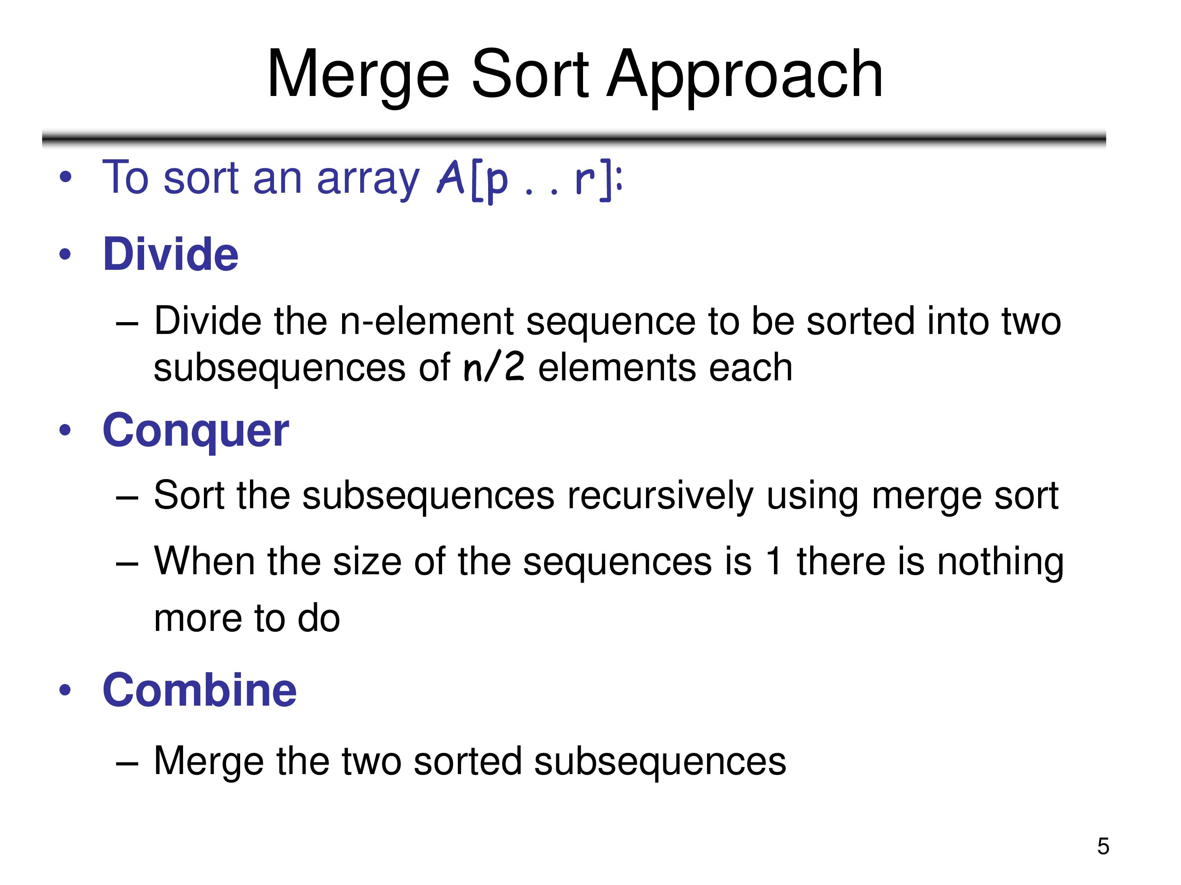

Slide 3
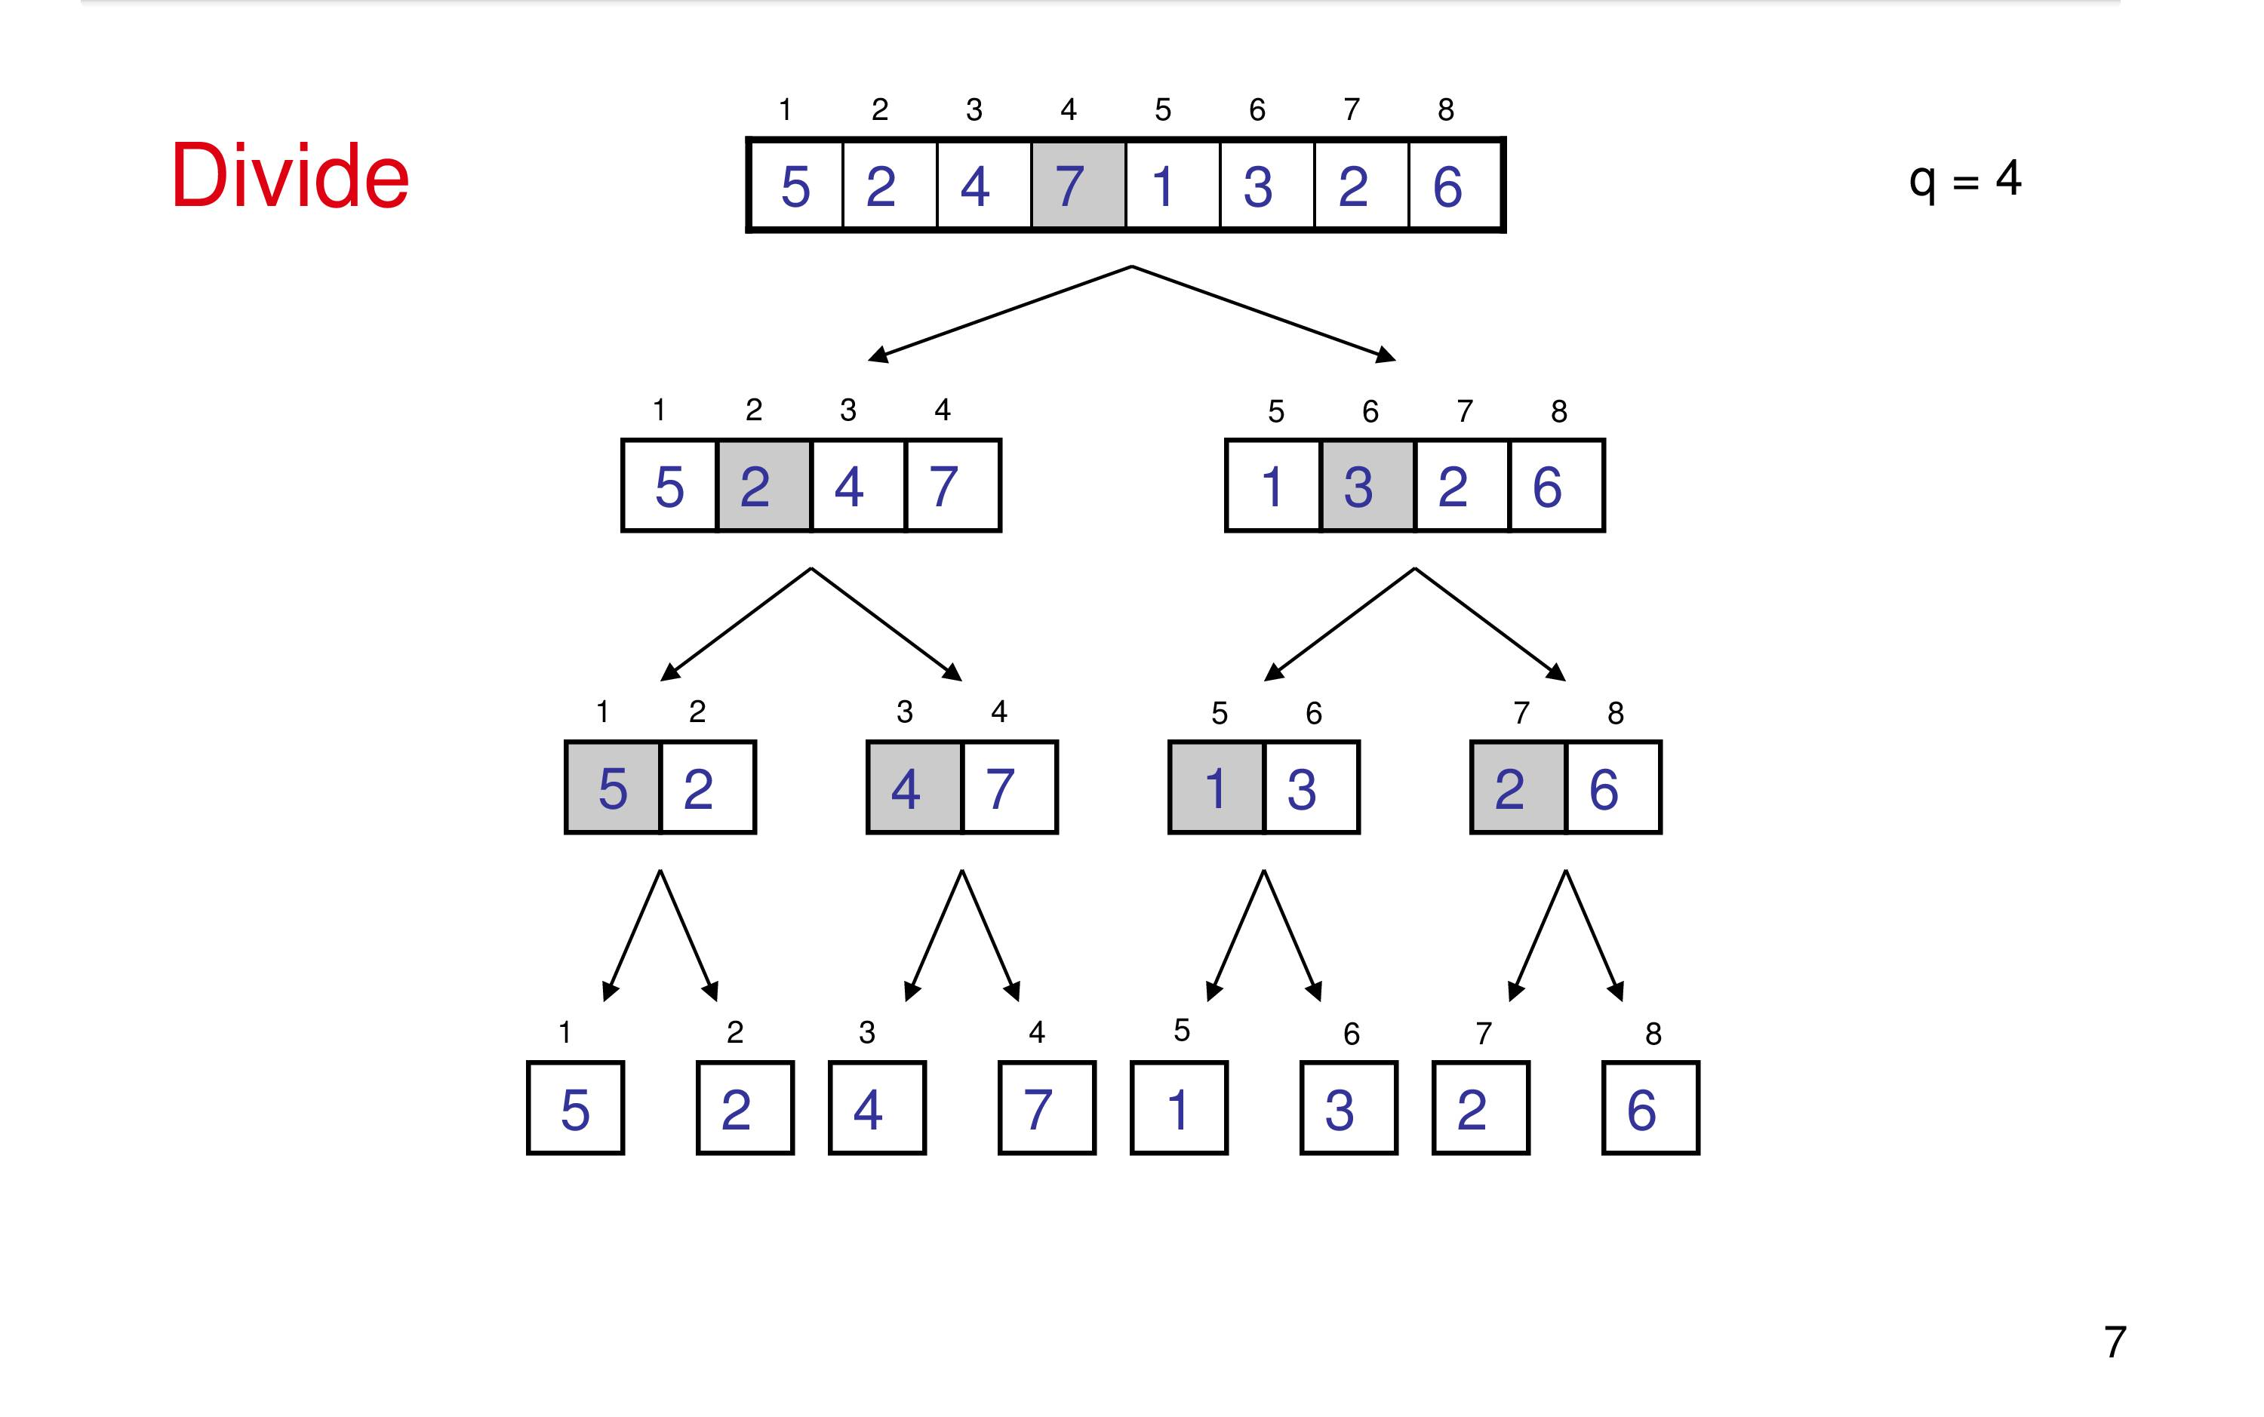

Slide 4
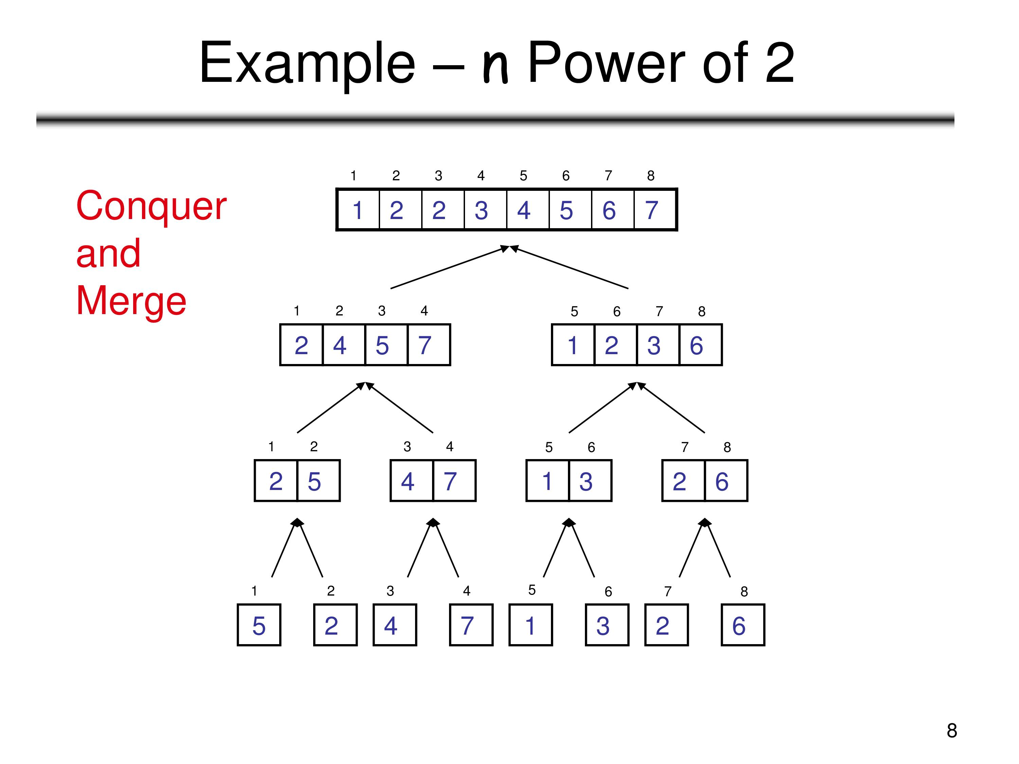

Slide 5
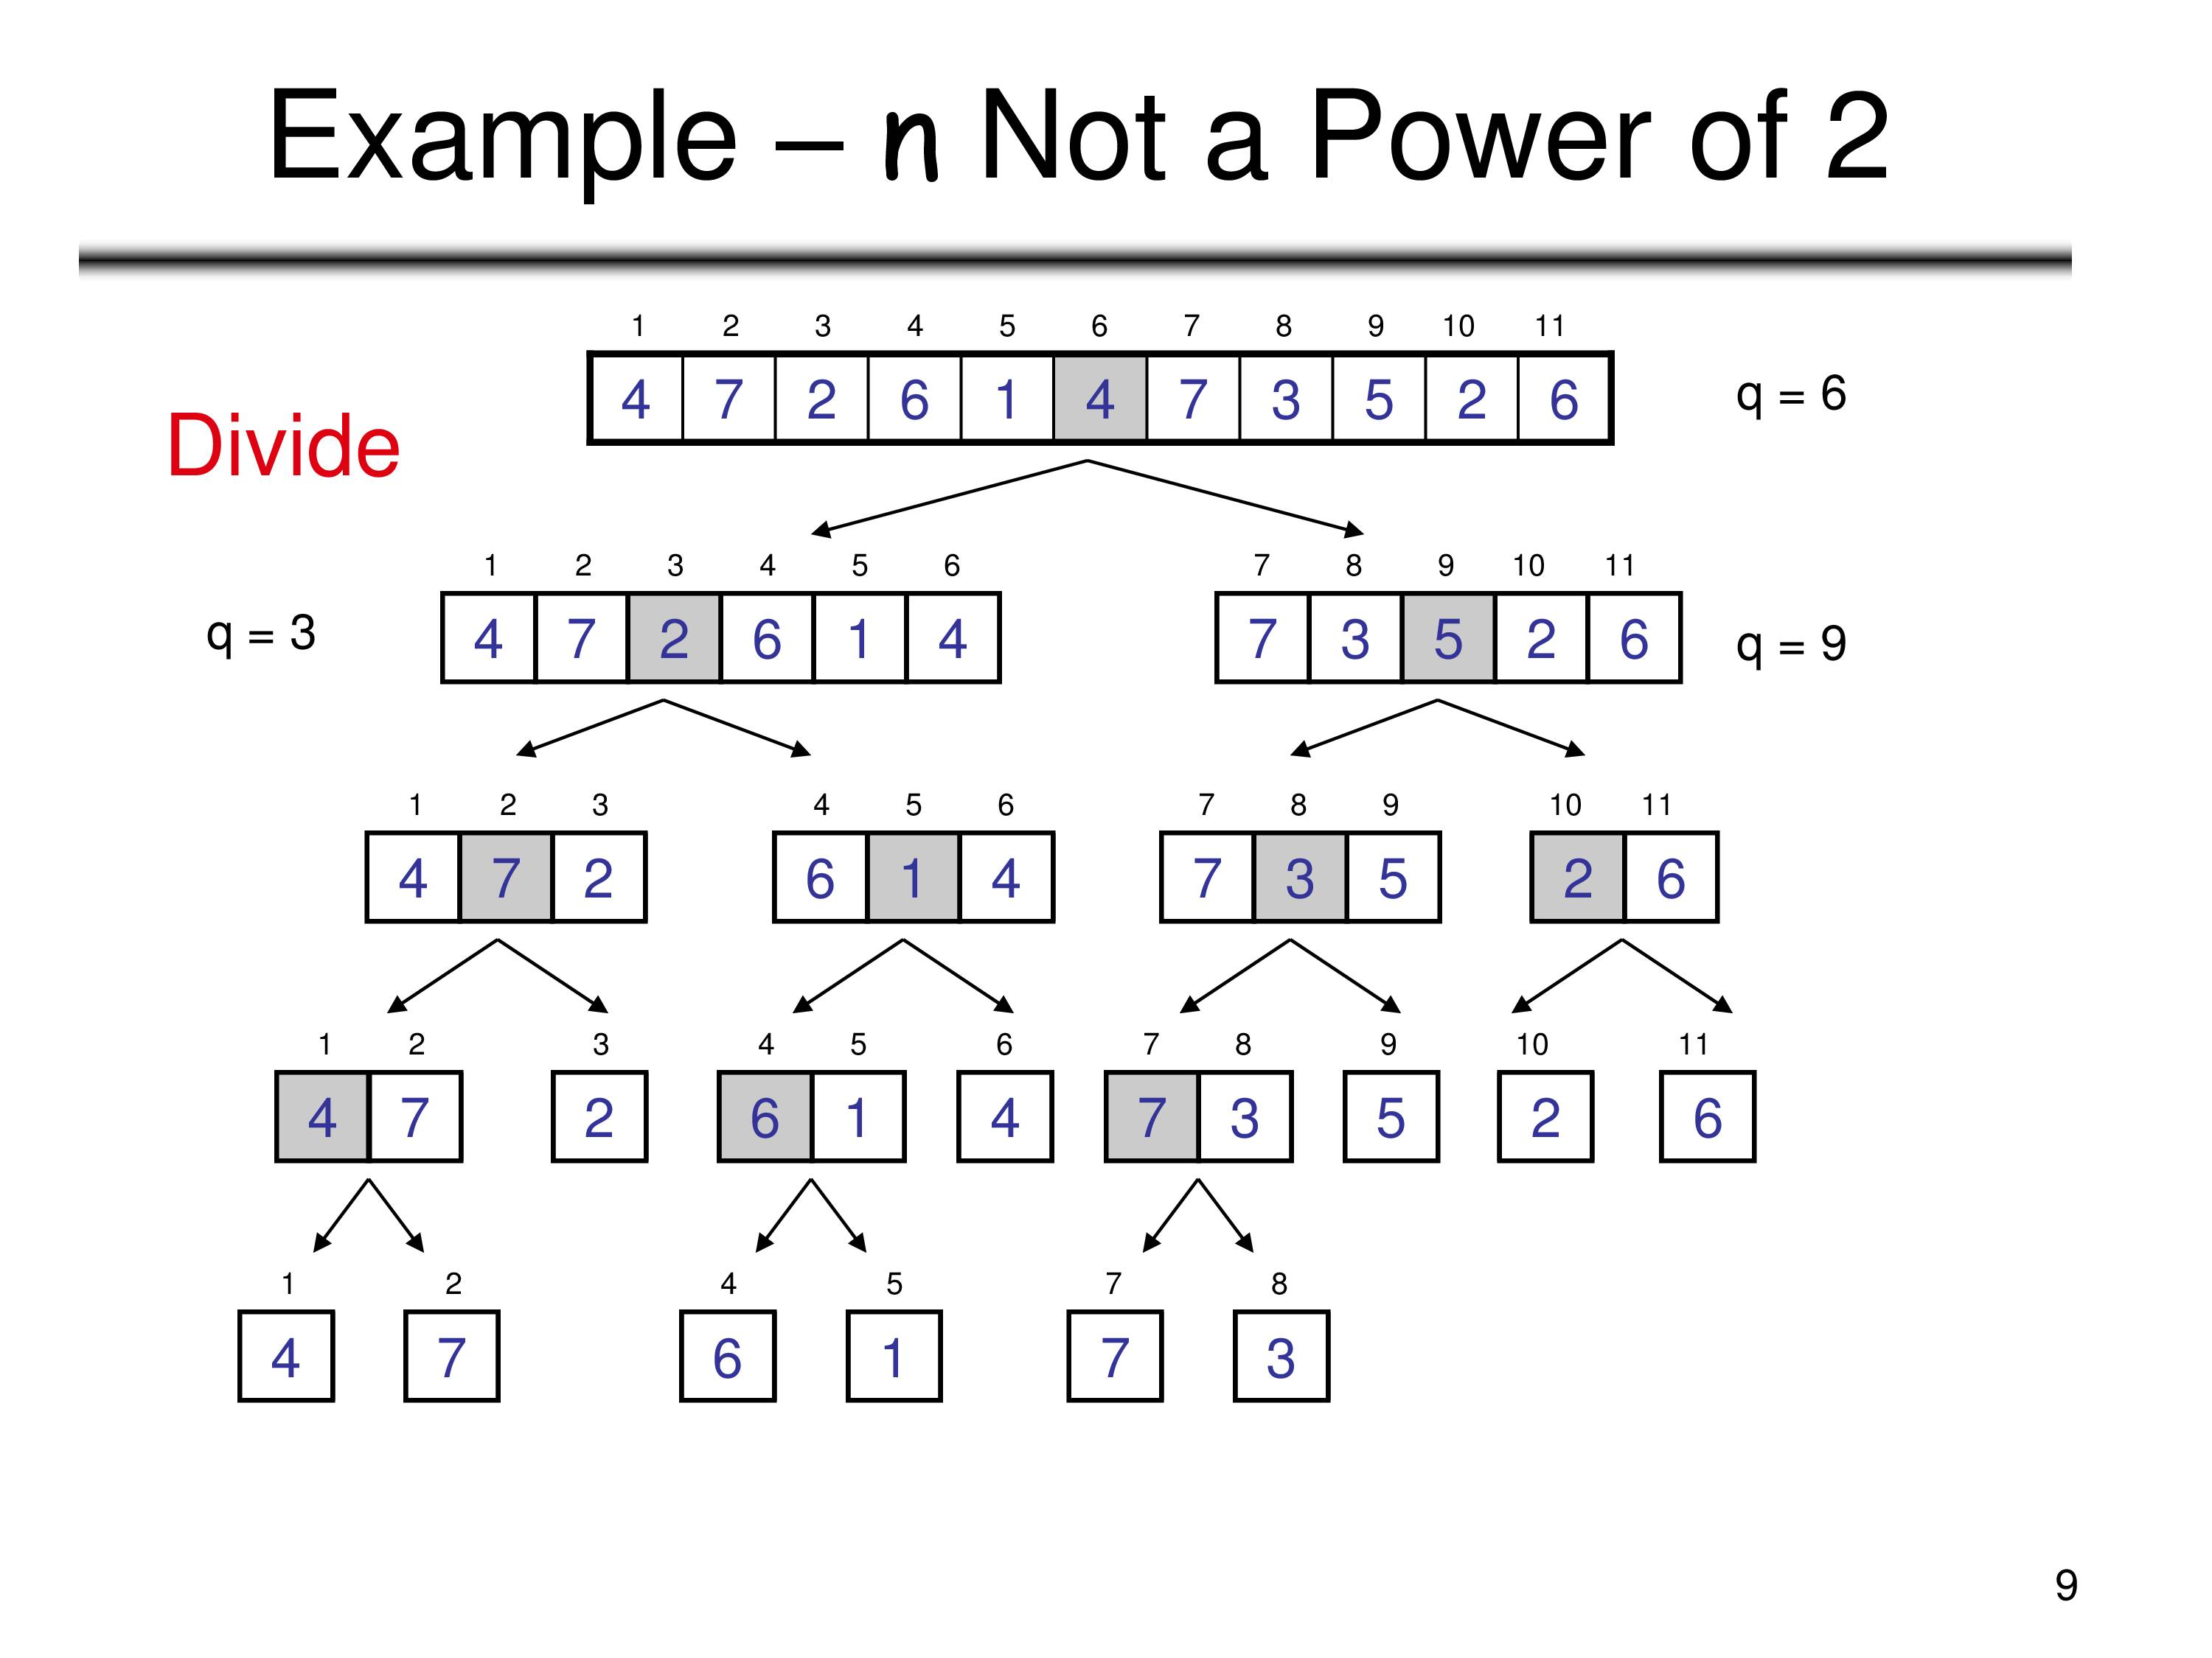

Slide 6
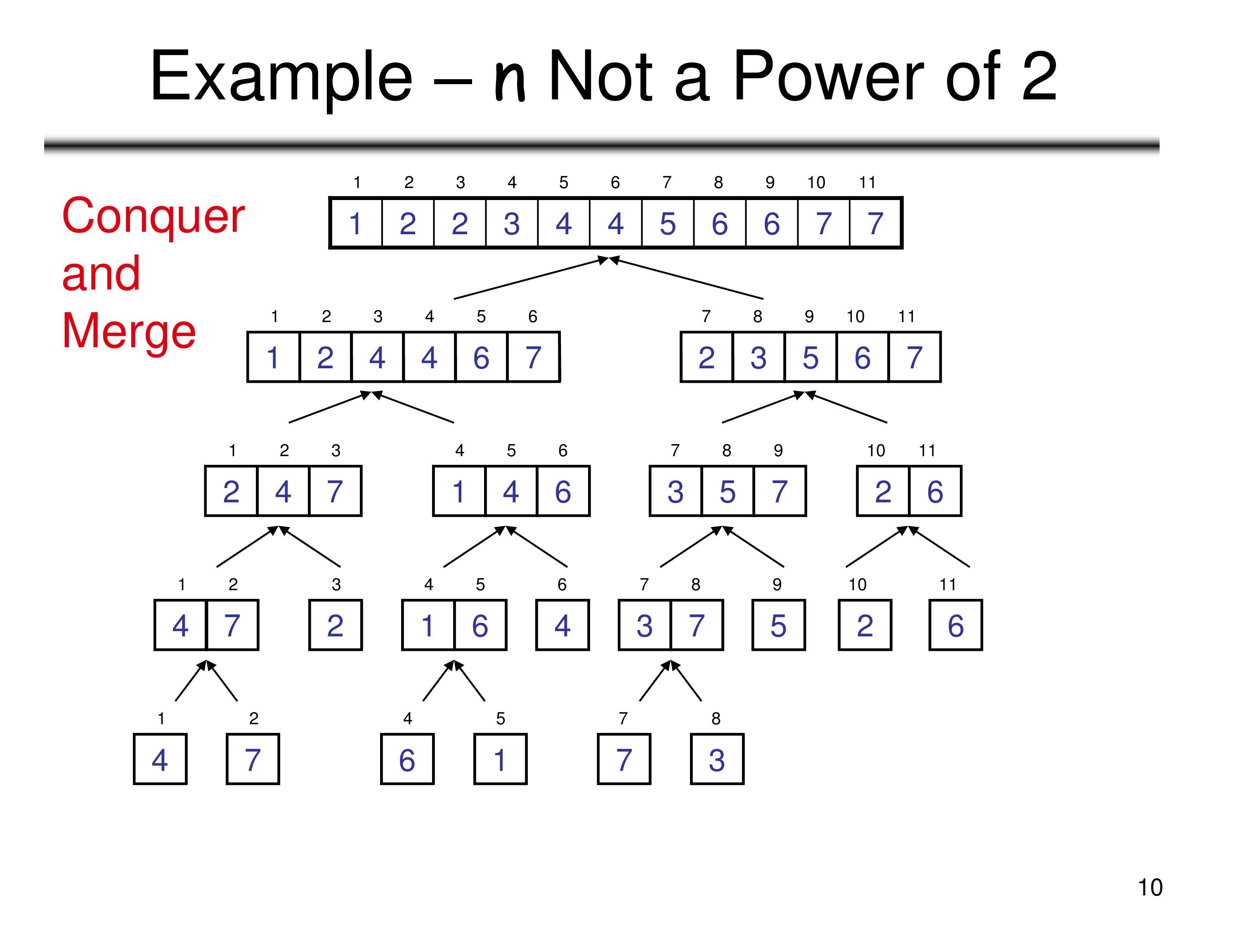

Slide 7
QUICK SORT
QuickSort is a Divide and Conquer algorithm. It picks an element as pivot and partitions the given array around the picked pivot.

Slide 8
